Slide 1
Demographic Transition Model
Intro and Historical Background

Slide 2
Demography
The scientific study of the characteristics of population
Age, gender, Birth Rates, etc

Slide 3
Demographic transition Model
Process of change in society’s birth and death Rates
There are four stages, possibly a fifth expected

Slide 4
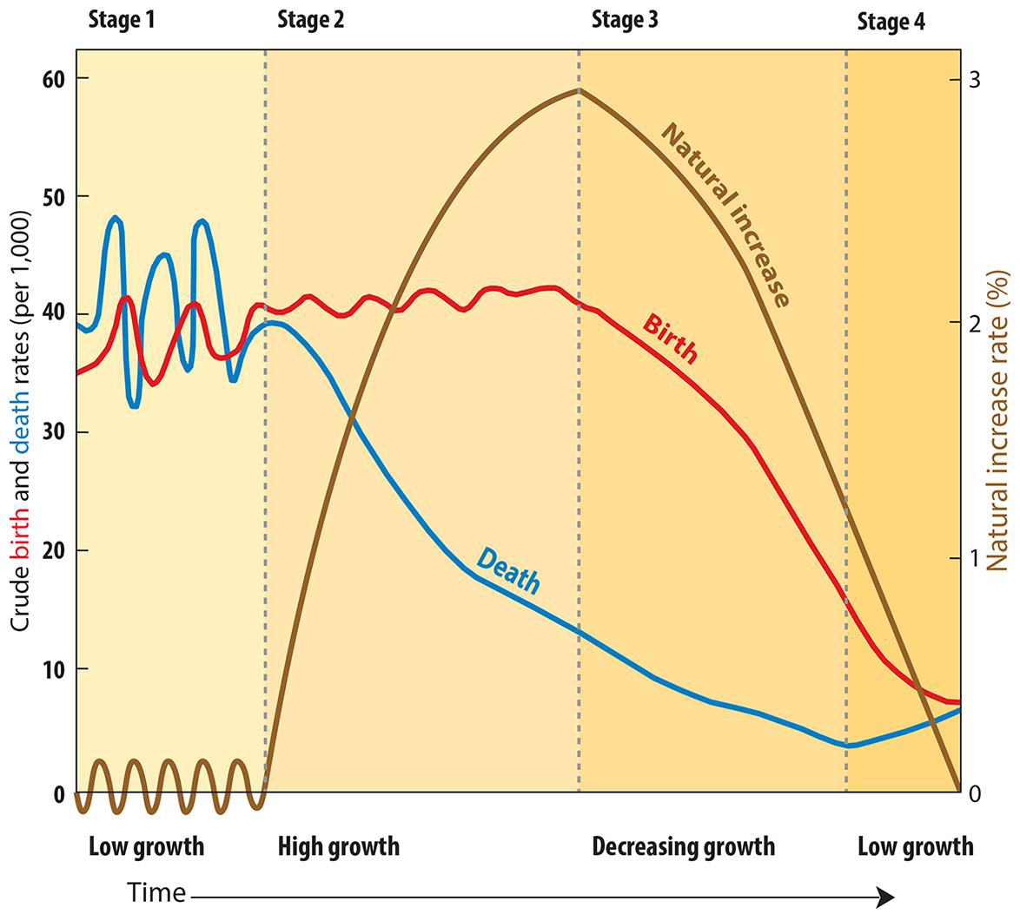

Slide 5
A study of England
Demographic Transition Model – Historical Context and background

Slide 6
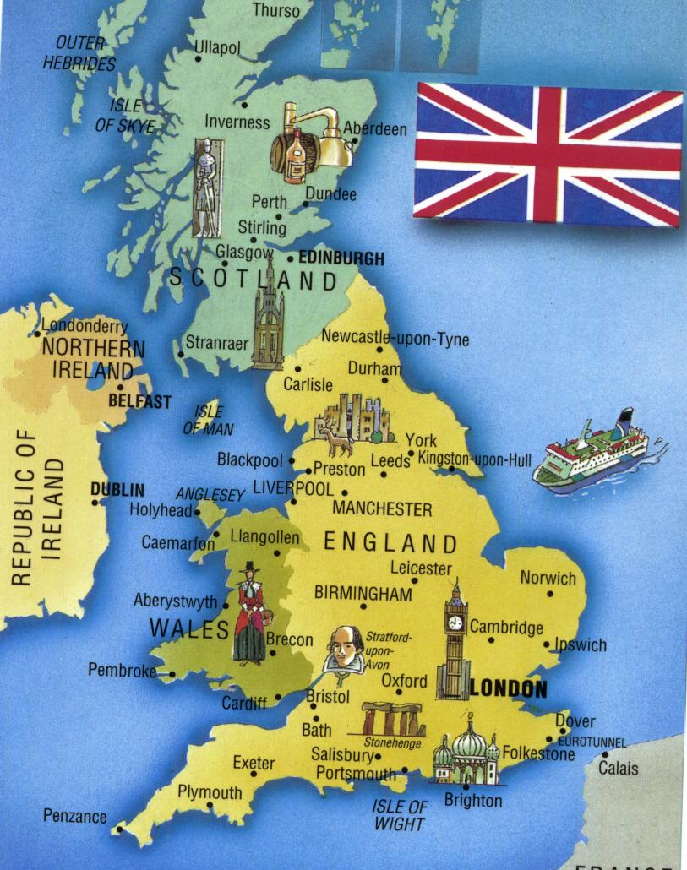

Slide 7
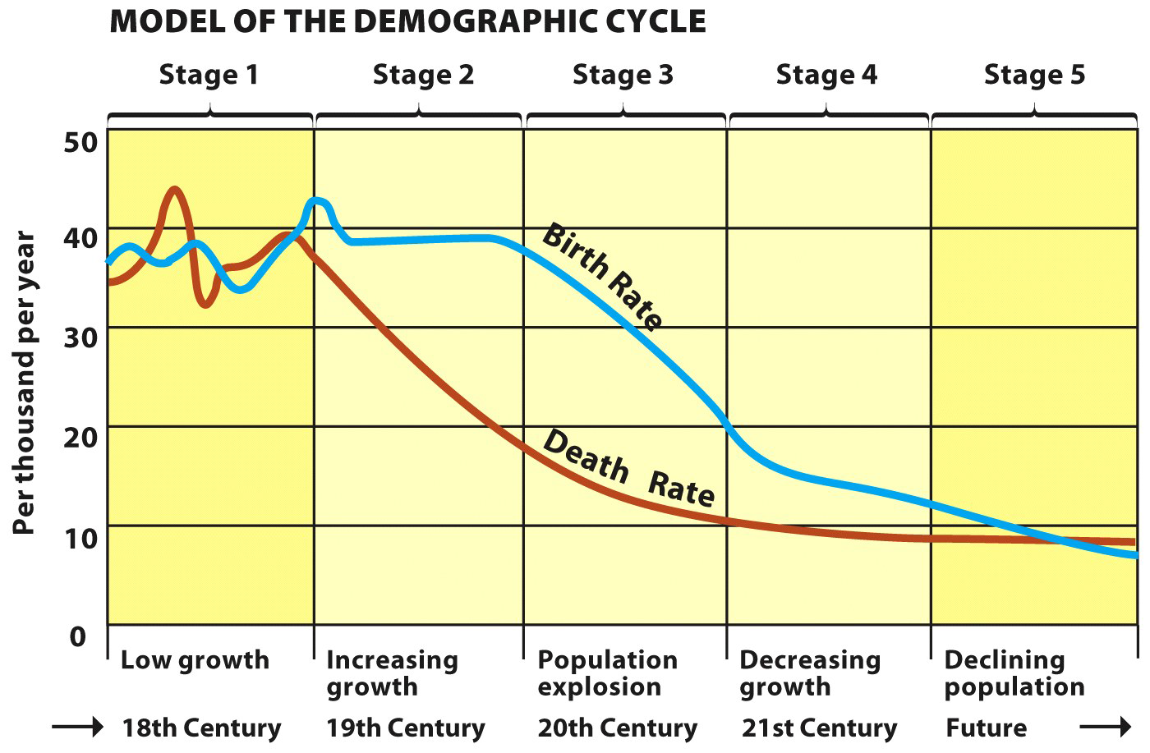

Slide 8
Pre-Industrial revolution England
Data from Births and Funerals from Churches was used to determine CDR/CBR
Before IR in 1750s
Births High
Deaths High
After IR 1750’s – high Births and Lower deaths
Conditions improved

Slide 9
Late 1800s forward- England
Death and Birth Rates fell
Births remained higher than death rates
Births slowed but population continued to grow

Slide 10
Recent History in England
Decline in Birth and Death Rates
Growth is slow and stabilized

Slide 11
Stage 1 of Demographic Transition Model
All of the Earth Had high Birth Rates, High Death Rates and Low NIR
Epidemics and Plagues caused the deaths
Bubonic Plague in 1300s diffused throughout the Continent
Famines reported in India and China during the 18th and 19th centuries – Millions died

Slide 12
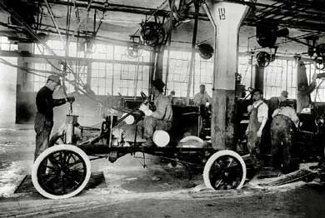
Industrial Revolution
Accelerated Population Growth

Slide 13
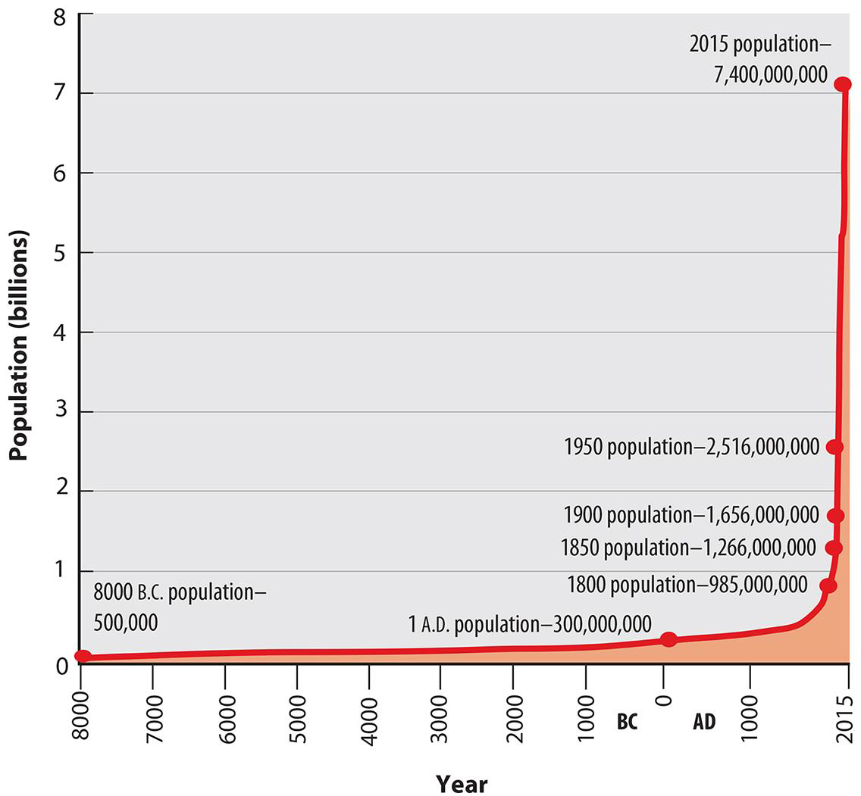

Slide 14
2nd Agricultural Revolution
Improved Seed Selection
Crop Rotation
Bred livestock more effectively
New Technology like the seed drill
Capacity to store food improved
Consolidated land holding for more efficiency
Number of people needed to farm decreased
Able to support the population

Slide 15
1800s Industrial revolution
Diffused throughout Europe
Death rates fell
Sanitation improved
Modern Medical Practices Diffused
Public heath, disease Prevention and Vaccination caused a drastic reduction in death rates
Before 1750 – CDR 35/1,000 live people
After 1850 – 16,/1,000 live people

Slide 16
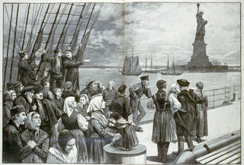
Migration
Millions Emigrated to other parts of the world

Slide 17
2nd Wave of Colonization
Europeans colonized Asia and Africa
Brought sanitation methods and Medical improvements
Mid 1900s declining death Rates in Africa, India, South America caused a population increase

Slide 18
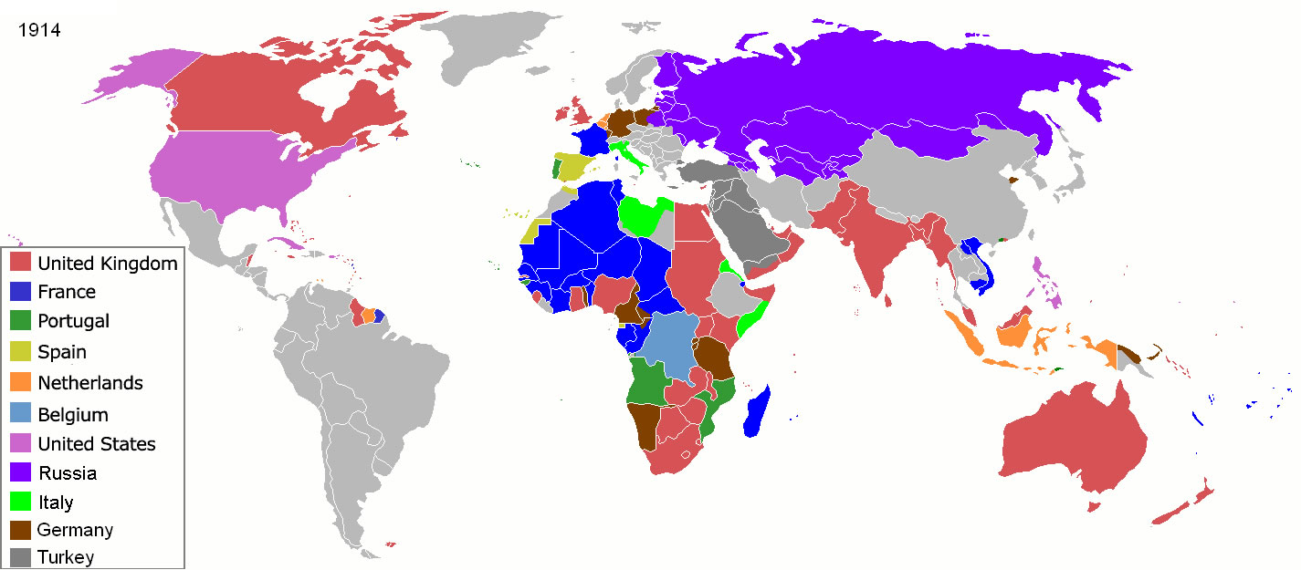

Slide 19
Overpopulation Concerns
Once population increased, people believed that there would be an overpopulation problem
Birthrates went down in urbanized countries
Wealth and Medical Advances caused birthrates to fall
New opportunities outside of the home for women were not compatible with large families

Slide 20
Medical Advances
Helped lower infant mortality and child mortality rates (vaccines, etc)
Diffusion of contraception, abortions, and decisions to have fewer children or to have children at a later age lowered birth rates

