Slide 1
Europe's Poppin Population
The European population cluster and the people in it

Slide 2
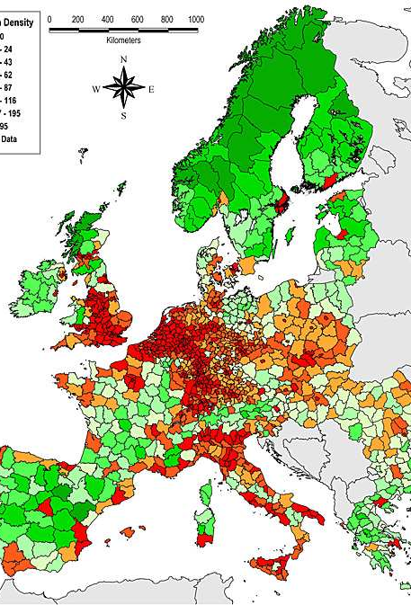
741.4 Million
People live throughout Europe

Slide 3
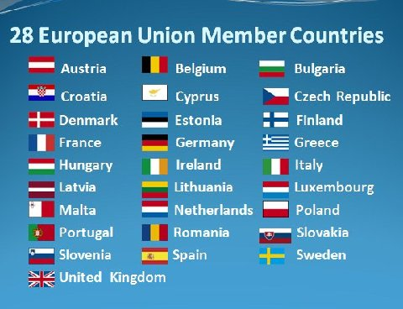
Countries in Europe
Norway, Iceland, Liechtenstein, Albania, Switzerland, Turkey, Russia, Macedonia and Montenegro. Of these, two countries, Russia and Turkey, straddle Europe and Asia.

Slide 4
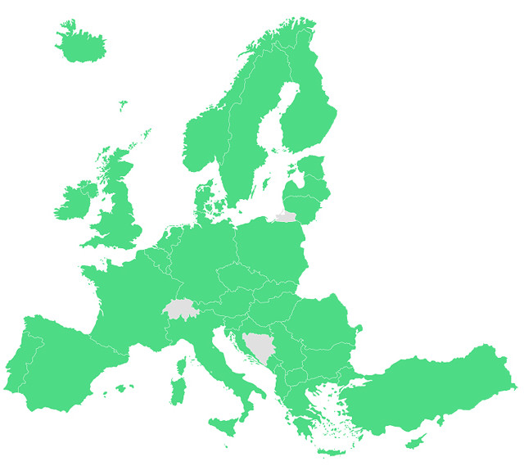
Clusters
¾ of Europe's Inhabitants live in cities with less than 5% of the population involved in agriculture.
The highest population concentrations in Europe is near the major rivers and coalfields of Germany and Belgium.

Slide 5

Jobs in Europe
Top three employing countries:
Germany (422,529) Electrical
United Kingdom (331,388) Shop Salesperson
Italy (66,264) Finance and Sales

Slide 6
Question
Why do you think ¾ of Europe's population lives in cities vs. in the countryside
Why might someone move to a city or the countryside

Slide 7
THANKS FOR TUNING IN!!!!

Slide 8

Presentation Provided by:
Kaliyah Lakes
Sa'Nyia Smith
Emma Troup
Zi'yon Reese

Slide 9
Works Cited
Websites
"Worldometers - Real Time World Statistics." Worldometers. N.p., 2018. Web. 28 Sept. 2018.
"Reference.Com - What's Your Question." reference.com. N.p., 2018. Web. 28 Sept. 2018.
"News, Sport And Opinion From The Guardian's UK Edition | The Guardian." the Guardian. N.p., 2018. Web. 28 Sept. 2018.
Book
Rubenstein, James M. Cultural Landscape. Harlow: Pearson Education UK, 2013. Print.

